Slide 1
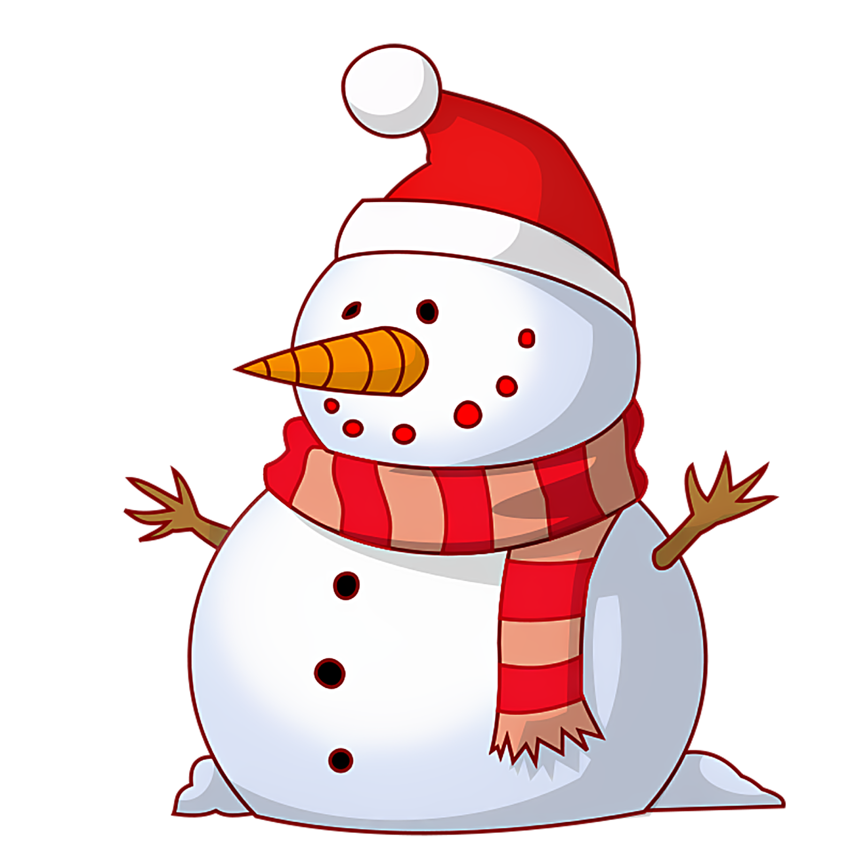
Enjoy the snow day!

Slide 2
No School Today

Slide 3
It’s Summer!

Slide 4
Today is Saturday.

Slide 5
Today is Sunday.

